Slide 1
Advanced Queries
Microsoft Access 2013
Lesson 12

Slide 2
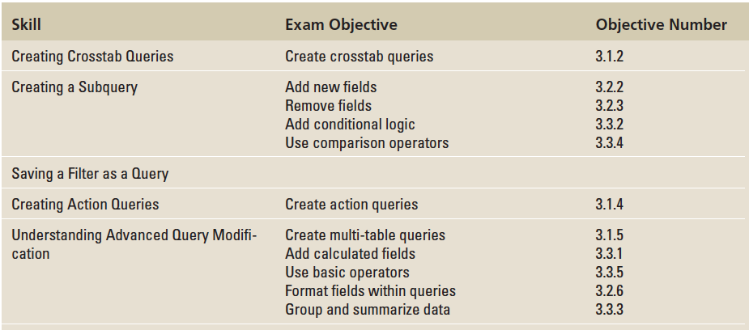
Objectives

Slide 3
Step by Step: Create Crosstab Queries
GET READY. Before you begin these steps, be sure to LAUNCH Microsoft Access.
OPEN the Importers database from the data files for this lesson.
SAVE the database as ImportersXXX (where XXX is your initials).

Slide 4
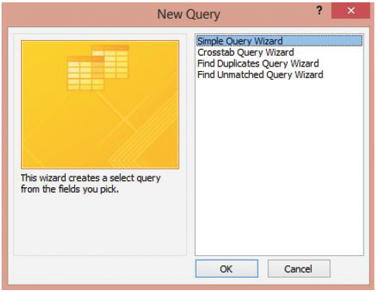
Step by Step: Create Crosstab Queries
On the CREATE tab, in the Queries group, click the Query Wizard button to display the New Query dialog box, shown at right.

Slide 5
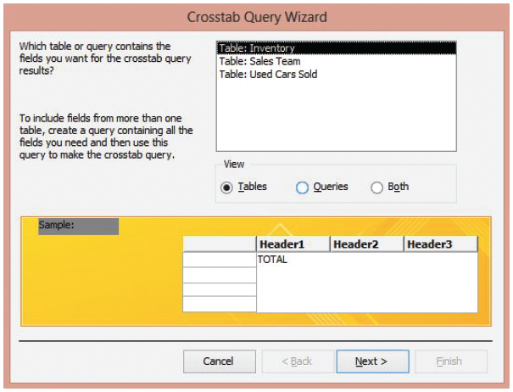
Step by Step: Create Crosstab Queries
Click Crosstab Query Wizard and click OK to display the Crosstab Query Wizard, shown at rights.

Slide 6
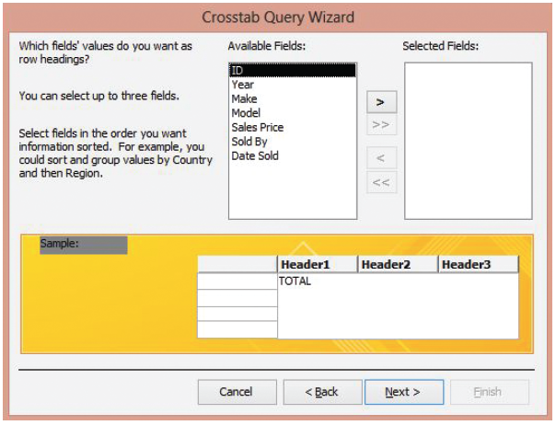
Step by Step: Create Crosstab Queries
Click Table: Used Cars Sold and then click Next > to display the next screen, shown at right.

Slide 7
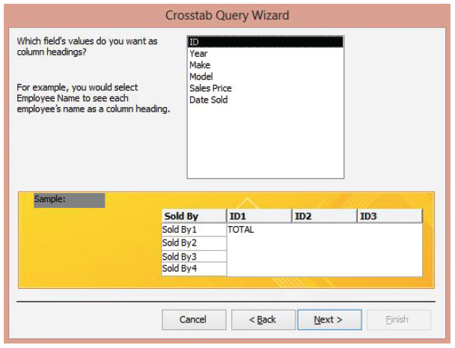
Step by Step: Create Crosstab Queries
In the Available Fields box, double-click Sold By to move it to the Selected Fields box and then click Next >. The next screen appears, as shown at right.

Slide 8
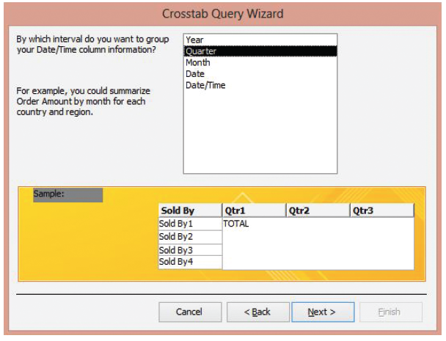
Step by Step: Create Crosstab Queries
Click Date Sold and then click Next > to display the next screen, as shown at right.

Slide 9
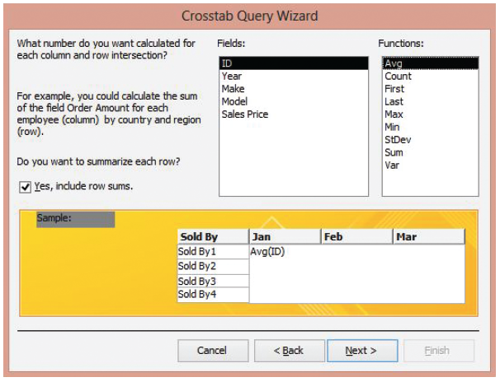
Step by Step: Create Crosstab Queries
Click Month and then click Next > to display the next screen, as shown at right.

Slide 10
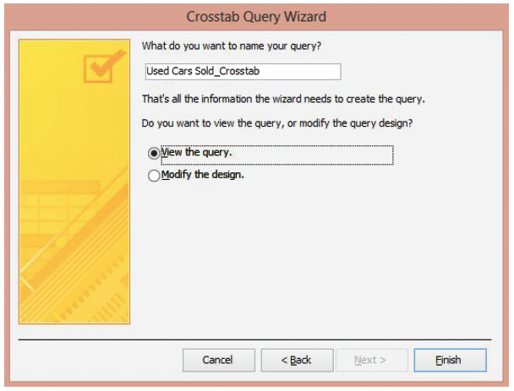
Step by Step: Create Crosstab Queries
In the Fields box, click Sales Price, and in the Functions box, click Sum. Click Next > to display the final screen, as shown at right.

Slide 11
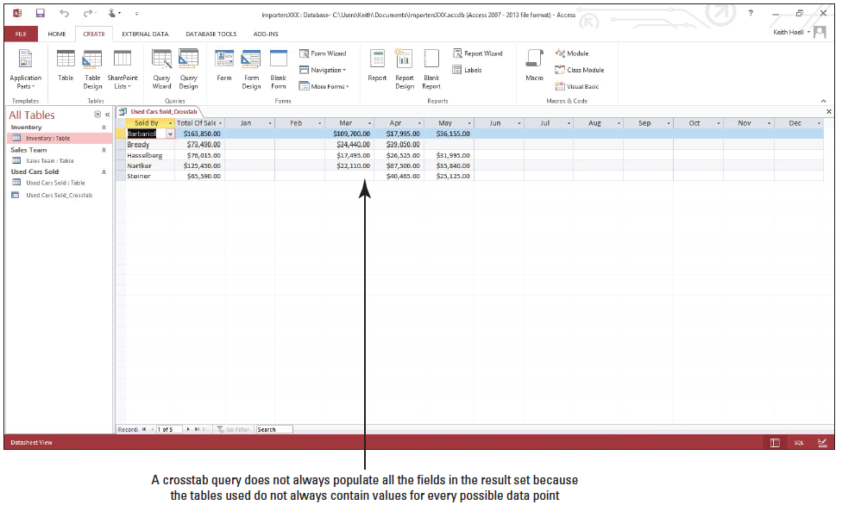
Step by Step: Create Crosstab Queries
Click Finish to display the results of the crosstab query, as shown below. A crosstab query does not always populate all the fields in the result set because the tables used do not always contain values for every possible data point.
Click the Close button to close the Used Cars Sold_Crosstab query.
PAUSE. LEAVE the database open to use in the next exercise.

Slide 12
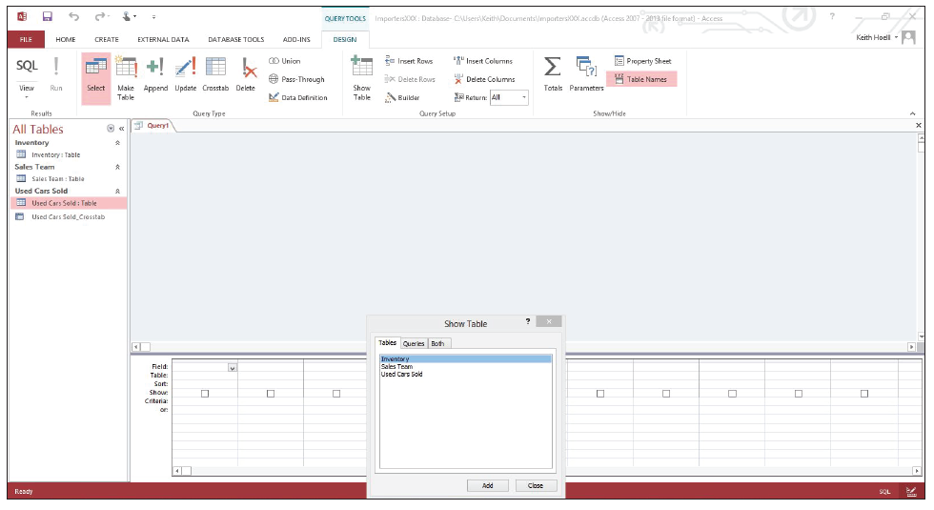
Step by Step: Create a Subquery
USE the database that is open from the previous exercise.
On the CREATE tab, in the Queries group, click Query Design. The query design grid opens, and the Show Table dialog box appears, as shown below.

Slide 13
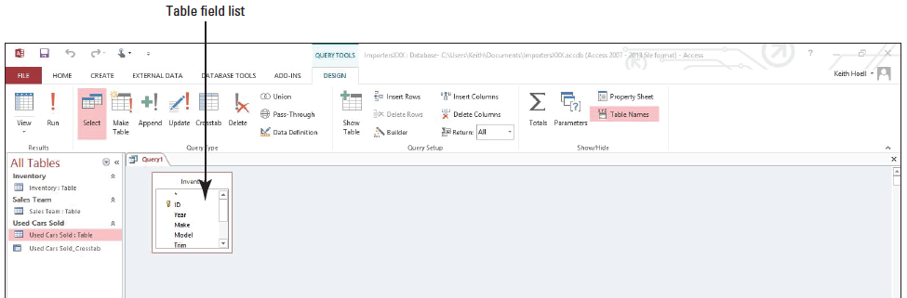
Step by Step: Create a Subquery
On the Tables tab, click Inventory, click Add, and then click Close. The table field list appears as a window in the upper section of the query design grid, as shown below.
Notes:
Another Way: To quickly add all the fields in a table, double-click the asterisk (*) at the top of the list of table fields.

Slide 14
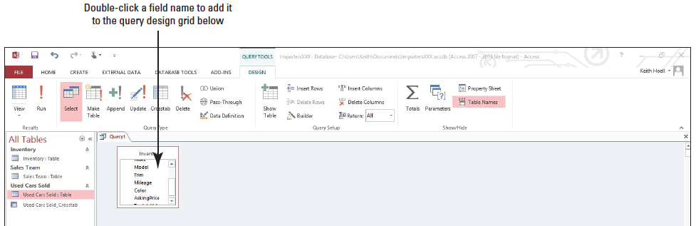
Step by Step: Create a Subquery
In the list of table fields, double-click Year, Make, Model, Trim, and AskingPrice to add those fields to the design grid, as shown below.

Slide 15
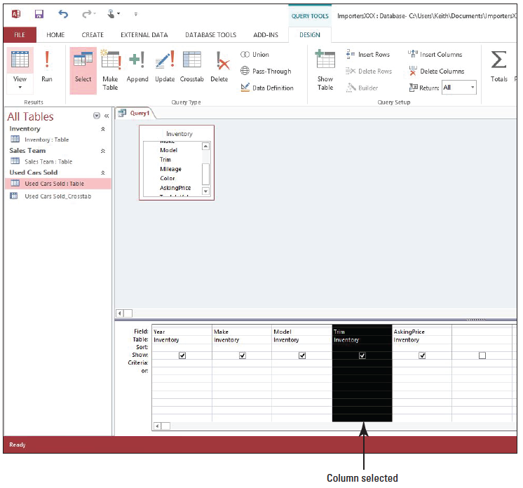
Step by Step: Create a Subquery
Move the insertion point above the Trim field on the design grid until it turns into a bold down arrow. Click to select and highlight the Trim column, as shown at right.
[Press the Delete key] on the keyboard and the Trim column is deleted. The AskingPrice field moves to the left to replace the Trim column.

Slide 16
Step by Step: Create a Subquery
Move the insertion point above the Model field on the design grid until it turns into a bold down arrow. Click to select and highlight the Model column.
On the DESIGN tab, in the Query Setup group, click the Delete Columns button. The Model column is deleted.
In the table field list in the Inventory table window, double-click the Model field to add it back to the query design grid as the last column.

Slide 17
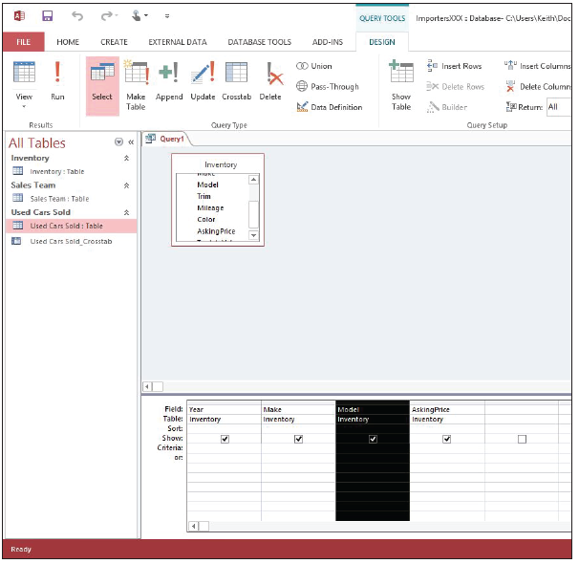
Step by Step: Create a Subquery
Move the insertion point above the Model field on the design grid until it turns into a bold down arrow. Click to select and highlight the Model column. Click and hold the mouse button down and drag the Model field to the left until the black vertical placeholder bar is positioned between the Make and AskingPrice fields, then release the mouse button. Your screen should resemble the figure above.

Slide 18
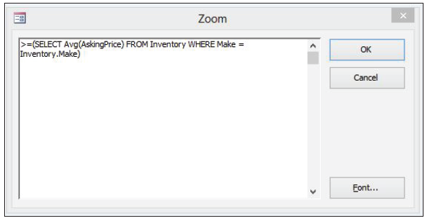
Step by Step: Create a Subquery
Place the insertion point in the Criteria row of the AskingPrice field and [press Shift1F2] to display the Zoom dialog box.
Key the following expression in the Zoom dialog box to have the query eventually return all car makes that have an asking price greater or equal to the average asking price for all makes:
> = (SELECT Avg(AskingPrice) FROM Inventory WHERE Make = Inventory.Make)
Notes:
Take Note: The Zoom dialog box is used to create a larger workspace to help you focus on expressions and limit typing errors.
Take Note: Since you are already working inside the Inventory table, the reference in the expression to the Inventory table preceding the Make field can be omitted and the expression can also be constructed as follows: .5(SELECT Avg(AskingPrice) FROM Inventory WHERE Make 5 Make)

Slide 19
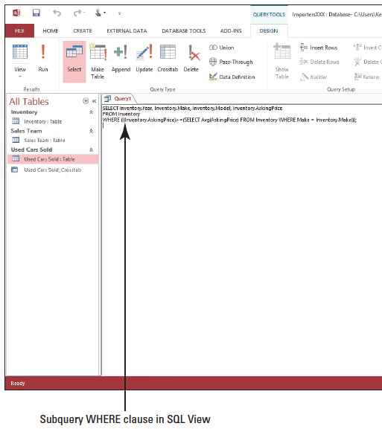
Step by Step: Create a Subquery
Click OK to insert the expression in the Criteria row of the AskingPrice field.
On the DESIGN tab, in the Results group, click the lower half of the View button and click SQL View to see the entire expression, as shown at right.

Slide 20
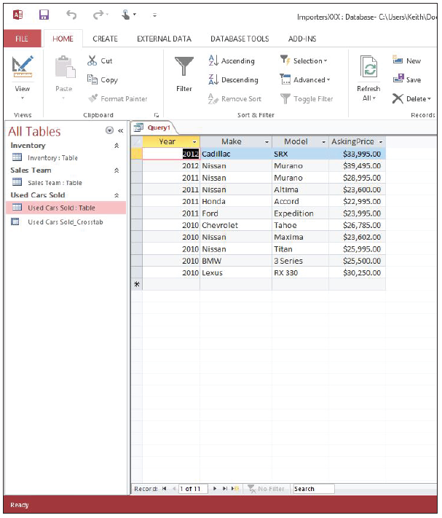
Step by Step: Create a Subquery
On the DESIGN tab, in the Results group, click Run. The query results are displayed, as shown at right.

Slide 21
Step by Step: Create a Subquery
Click the FILE tab and click Save.
In the Save As dialog box, key Subquery as the query name and click OK.
Click the Close button to close the Subquery query.
PAUSE. LEAVE the database open to use in the next exercise.

Slide 22
Step by Step: Save a Filter as a Query
USE the database that is open from the previous exercise.
On the CREATE tab, in the Queries group, click the Query Wizard button.
In the New Query dialog box, click Simple Query Wizard and click OK.
In the Tables/Queries drop-down list, click Table: Used Cars Sold.
Click the >> button to move all the fields from the Available Fields box to the Selected Fields box and then click Next >.
Click Next > again and then click Finish to display a simple select query.

Slide 23
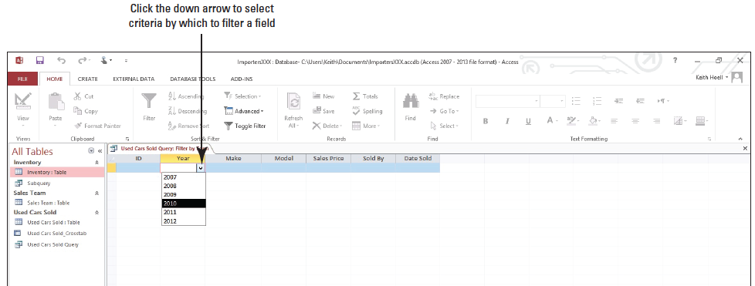
Step by Step: Save a Filter as a Query
On the HOME tab, in the Sort & Filter group, click the Advanced button and then click Filter by Form.
In Filter by Form view, click the Year field down arrow and click 2010, as shown below.

Slide 24
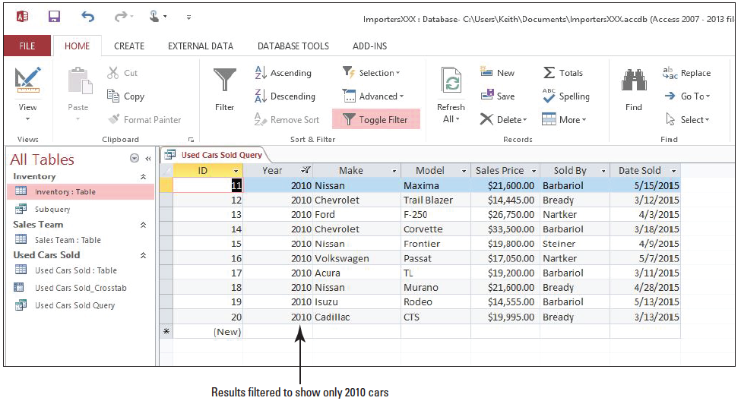
Step by Step: Save a Filter as a Query
On the HOME tab, in the Sort & Filter group, click the Toggle Filter button to apply the filter. The results are displayed, as shown below.

Slide 25
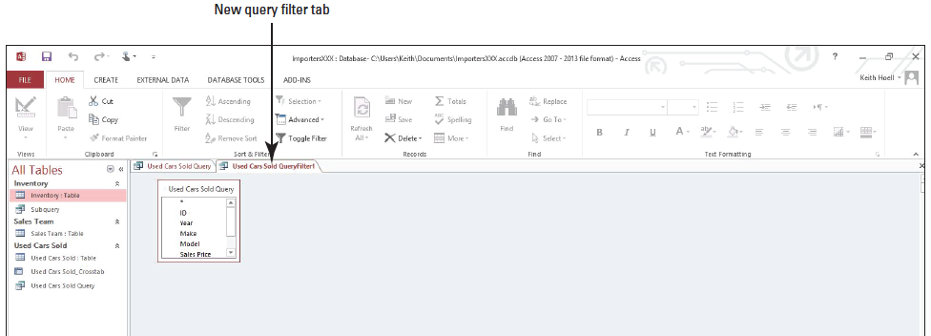
Step by Step: Save a Filter as a Query
On the HOME tab, in the Sort & Filter group, click the Advanced button and then click Advanced Filter/Sort to display the new query design grid, as shown below.

Slide 26
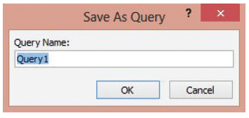
Step by Step: Save a Filter as a Query
On the HOME tab, in the Sort & Filter group, click the Advanced button and then click Save As Query. The Save As Query dialog box appears, as shown at right.

Slide 27
Step by Step: Save a Filter as a Query
Key Filter Query in the Query Name box and click OK.
Click the Close button to close the Used Cars Sold QueryFilter1 query.
On the HOME tab, in the Sort & Filter group, click the Toggle Filter button to remove the filter.
Click the Close button to close the Used Cars Sold Query and save the changes when prompted. If another dialog box appears informing you that another user may have changed the data, click Yes.
PAUSE. LEAVE the database open to use in the next exercise.

Slide 28
Step by Step: Create an Append Query
USE the database that is open from the previous exercise.
On the CREATE tab, in the Queries group, click the Query Design button.
In the Show Table dialog box, double-click Inventory to add it to the upper section of the query design grid.
Click Close to close the Show Table dialog box.

Slide 29
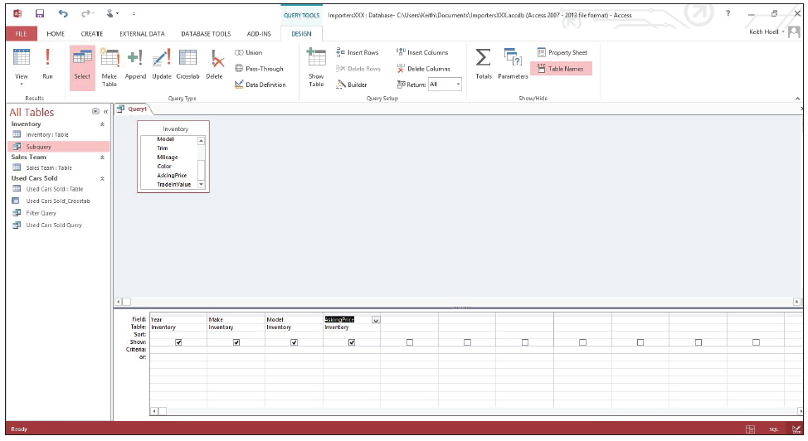
Step by Step: Create an Append Query
In the list of table fields, double-click Year, Make, Model, and Asking Price to add those fields to the design grid. Your screen should look similar to the figure below.

Slide 30
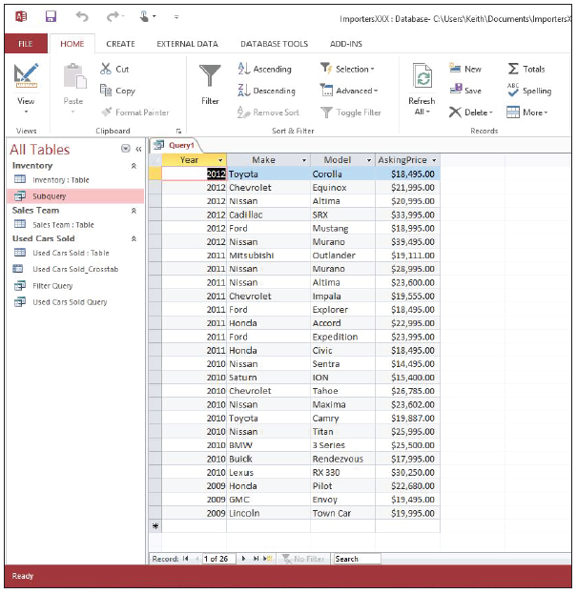
Step by Step: Create an Append Query
On the DESIGN tab, in the Results group, click Run. Verify that the query returned the records that you want to append, as shown at right.
Right-click the document tab (titled Query1) for the open query and click Design View on the shortcut menu.
Notes:
Take Note: If you need to add or remove fields from the query, switch back to Design view and double-click to add fields or select the fields that you don’t want and press Delete to remove them from the query.

Slide 31
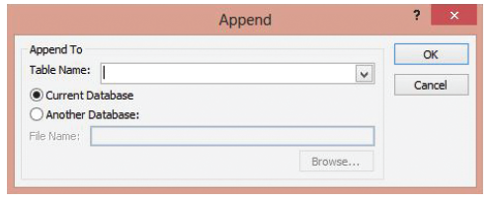
Step by Step: Create an Append Query
On the DESIGN tab, in the Query Type group, click Append. The Append dialog box appears, as shown below.
In the Table Name box, click the down arrow and click Used Cars Sold. This is the table you want to append to. The Current Database option button should be selected.
Click OK. Access automatically adds the names of the destination fields that match the source field names to the Append To row in the design grid. Because the Asking Price field doesn’t have a match, Access leaves that field blank.

Slide 32
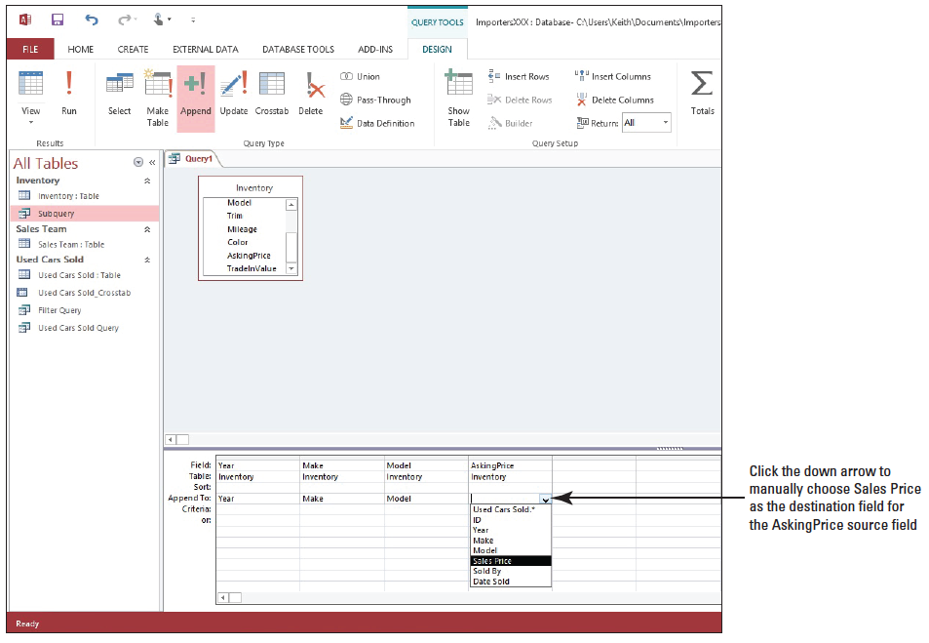
Step by Step: Create an Append Query
Click the blank field in the Append To row under the Asking Price cell and select Sales Price as the destination field, as shown at right. Click the down arrow to manually choose Sales Price as the destination field for the AskingPrice source field

Slide 33
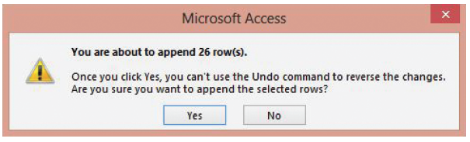
Step by Step: Create an Append Query
Right-click the document tab for the query, and then click Datasheet View to preview your changes.
Right-click the document tab for the query, and then click Design View.
On the DESIGN tab, in the Results group, click Run. An alert message appears, as shown below.
Click Yes.

Slide 34
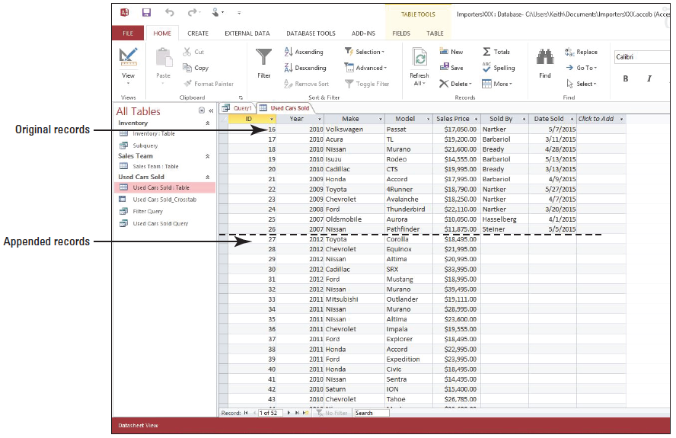
Step by Step: Create an Append Query
Open the Used Cars Sold table and scroll down to see that the records from the Inventory table have been appended to the end, as shown at right.

Slide 35
Step by Step: Create an Append Query
Click the Close button to close the Used Cars Sold table.
Click the FILE tab and click Save.
In the Save As dialog box, key Append Query as the query name and click OK.
Click the Close button on Append Query to close the query.
PAUSE. LEAVE Access open to use in the next exercise.

Slide 36
Step by Step: Create a Make Table Query
USE the database that is open from the previous exercise.
On the CREATE tab, in the Queries group, click the Query Wizard button.
In the New Query dialog box, click Simple Query Wizard and click OK.
In the Tables/Queries drop-down list, click Table: Sales Team.
Click the >> button to move all the fields from the Available Fields to the Selected Fields box and then click Next >.
Click Finish to display a simple select query.

Slide 37
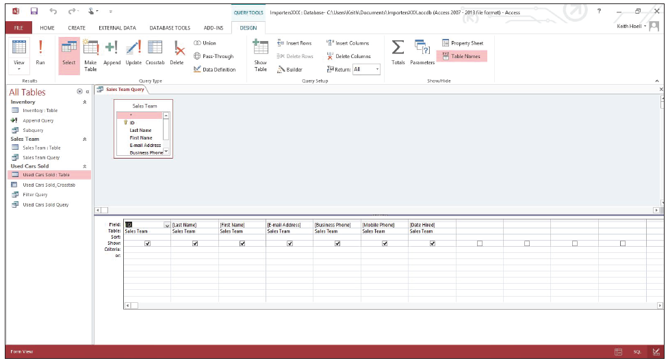
Step by Step: Create a Make Table Query
Right-click the Sales Team Query document tab and click Design View to display the query in Design view, as shown below.

Slide 38
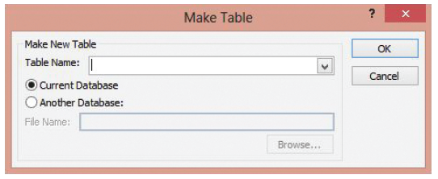
Step by Step: Create a Make Table Query
On the DESIGN tab, in the Query Type group, click Make Table. The Make Table dialog box appears, as shown below.
In the Table Name box, key Sales Team Backup. If it isn’t already selected, click Current Database, and then click OK.

Slide 39
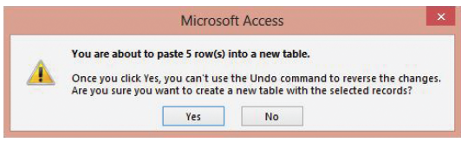
Step by Step: Create a Make Table Query
On the DESIGN tab, in the Results group, click Run. An alert message appears, as shown below.
Click Yes. A new table named Sales Team Backup appears in the Navigation Pane.

Slide 40
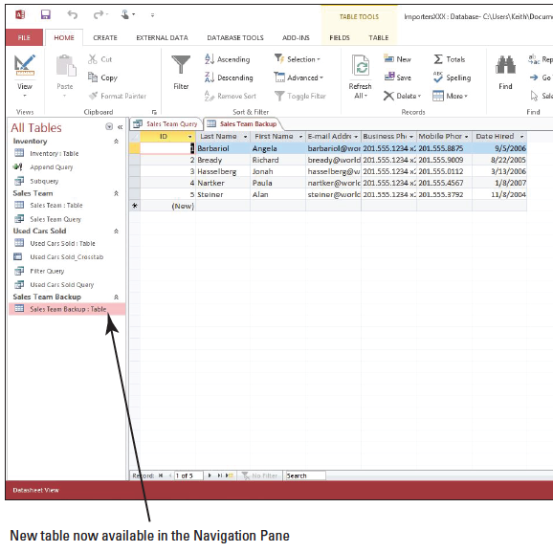
Step by Step: Create a Make Table Query
Double-click Sales Team Backup: Table in the Navigation Pane to open the new table, as shown at right.
Click the Close button to close the Sales Team Backup table.
Click the Close button to close the Sales Team query. Save the changes when prompted.
LEAVE the database open.
PAUSE. LEAVE Access open to use in the next exercise.

Slide 41
Step by Step: Create an Update Query
USE the database that is open from the previous exercise.
On the CREATE tab, in the Queries group, click the Query Wizard button.
In the New Query dialog box, click Simple Query Wizard and click OK.
In the Tables/Queries drop-down list, click Table: Inventory.
Click the >> button to move all the fields from the Available Fields to the Selected Fields box.
Click Trim and then the < button to move it back to the Available Fields box. Click Color and then the < button to move it back to the Available Fields box. Click Next >.

Slide 42
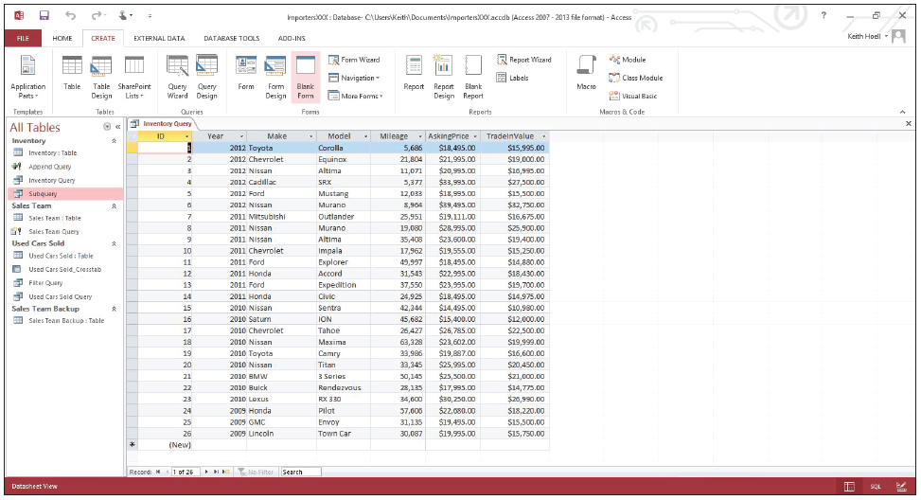
Step by Step: Create an Update Query
Click Next > again and then click Finish to display a simple select query in Datasheet view, as shown below.
Right-click the Inventory Query document tab and click Design View to display the query in Design view.

Slide 43
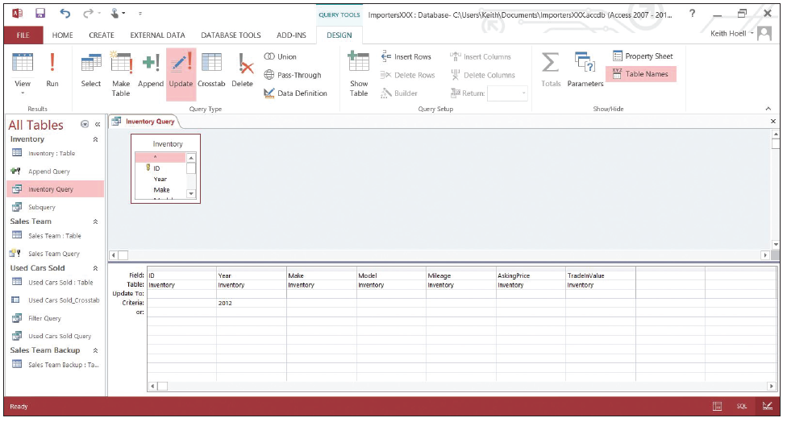
Step by Step: Create an Update Query
Key 2012 in the Criteria row of the Year field.
On the DESIGN tab, in the Query Type group, click Update. Access adds the Update To row in the query design grid, as shown below.

Slide 44
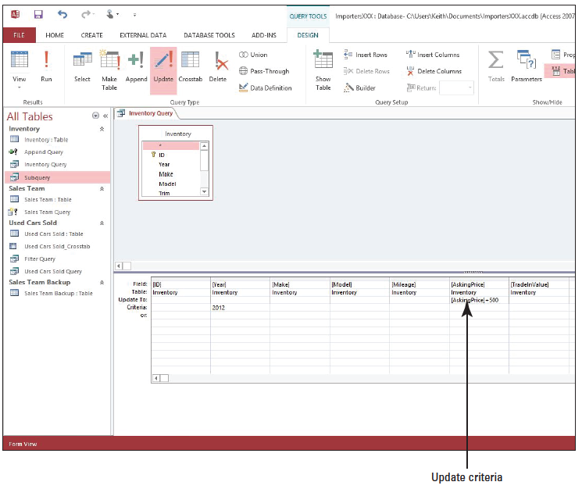
Step by Step: Create an Update Query
In the Update To row of the AskingPrice field, key [AskingPrice] + 500. The design grid should look similar to the figure at right.

Slide 45
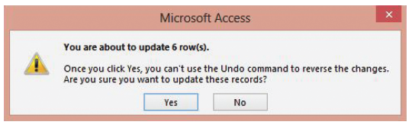
Step by Step: Create an Update Query
On the DESIGN tab, in the Results group, click Run. An alert message appears, as shown below.
Click Yes.

Slide 46
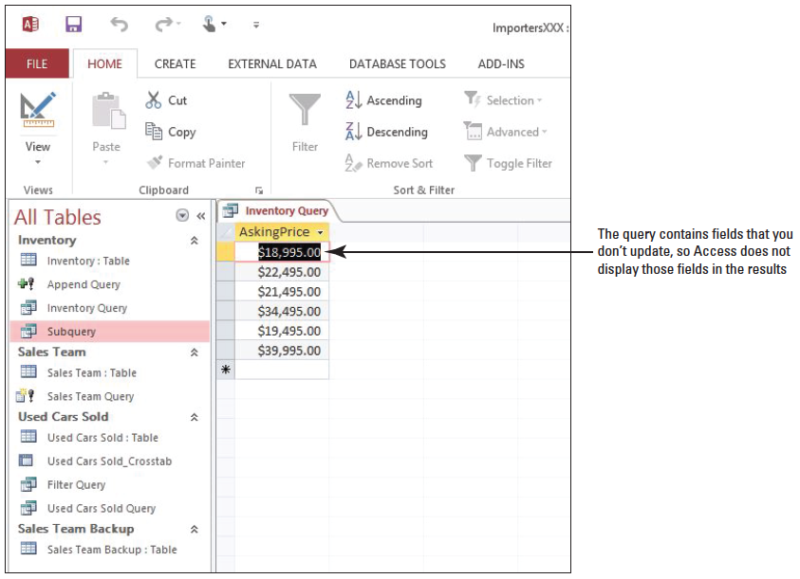
Step by Step: Create an Update Query
Right-click the Inventory Query document tab and click Datasheet View to display the update query results, as shown at right.

Slide 47
Step by Step: Create an Update Query
Click the Close button to close the Inventory query. Save the changes when prompted.
Double-click Inventory: Table in the Navigation Pane to open it. Notice that the asking price for all 2012 cars has been increased by $500.
Click the Close button to close the Inventory table.
LEAVE the database open.
PAUSE. LEAVE Access open to use in the next exercise.

Slide 48
Step by Step: Create a Delete Query
USE the database that is open from the previous exercise.
On the CREATE tab, in the Queries group, click Query Wizard.
In the New Query dialog box, click Simple Query Wizard and click OK.
In the Tables/Queries drop-down list, click Table: Used Cars Sold.
Click the >> button to move all the fields from the Available Fields to the Selected Fields box and then click Next >.
Click Next > again.
Key Delete Query as the title and then click Finish to display the results of the simple select query.
Right-click the Delete Query document tab and click Design View to display the query in Design view.

Slide 49
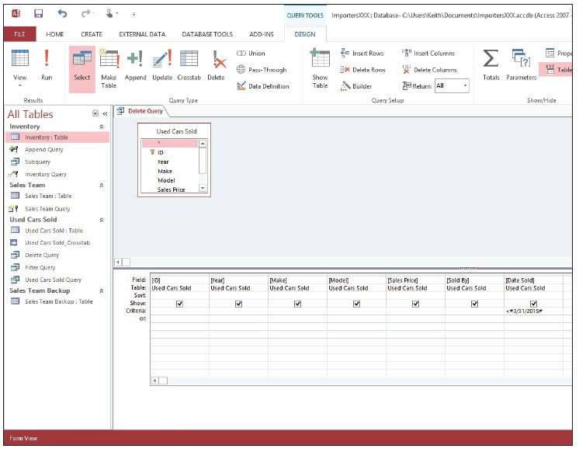
Step by Step: Create a Delete Query
Key , #3/31/2015# in the Criteria row of the Date Sold field, as shown below.

Slide 50
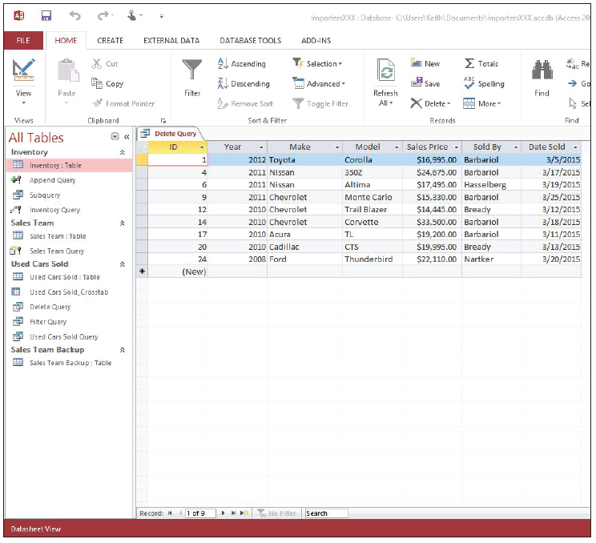
Step by Step: Create a Delete Query
On the DESIGN tab, in the Results group, click Run to display the records to be deleted, as shown at right.
Right-click the Delete Query document tab and click Design View to display the query in Design view.

Slide 51
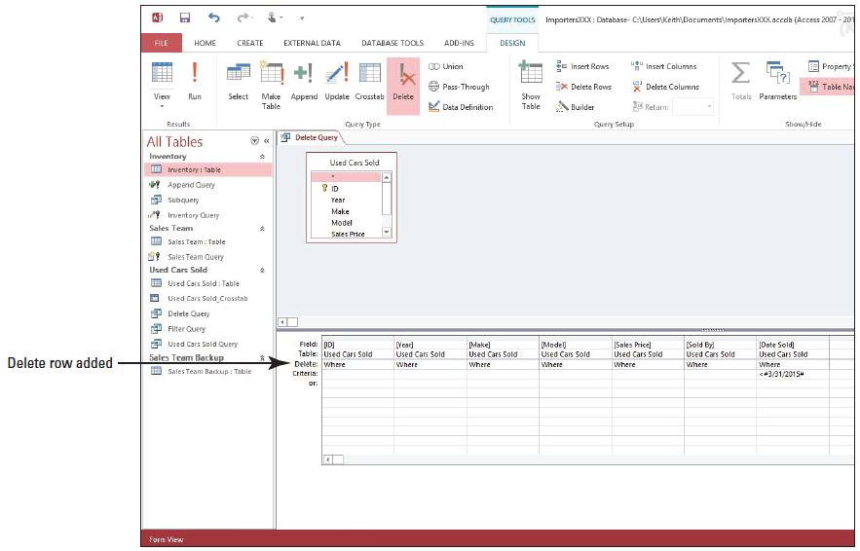
Step by Step: Create a Delete Query
On the DESIGN tab, in the Query Type group, click Delete. Access hides the Show row in the lower section of the design grid and adds the Delete row, as shown below.

Slide 52
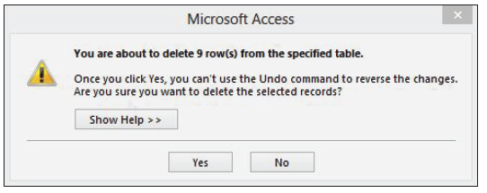
Step by Step: Create a Delete Query
On the DESIGN tab, in the Results group, click Run. An alert message appears, as shown below.
Click Yes.

Slide 53
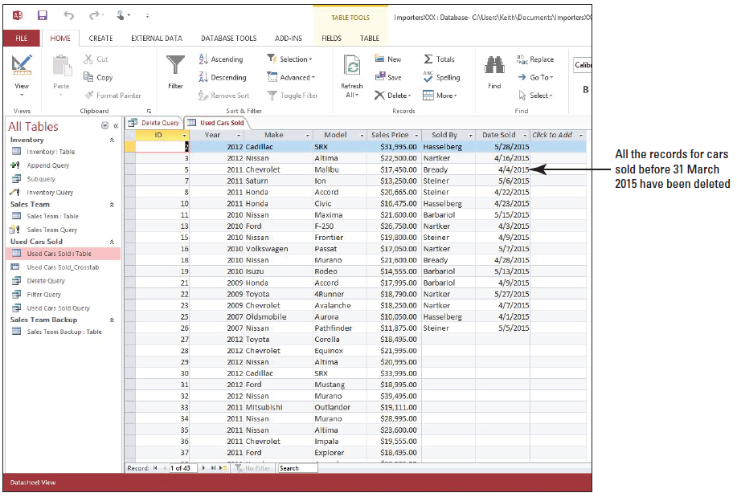
Step by Step: Create a Delete Query
Double-click Used Cars Sold: Table in the Navigation Pane to open it. Notice that all the records for cars sold before March 31, 2015, have been deleted, as shown below.

Slide 54
Step by Step: Create a Delete Query
Click the Close button on Used Cars Sold to close the table.
Click the Close button on Delete Query to close the query. SAVE the changes when prompted.
LEAVE the database open.
PAUSE. LEAVE Access open to use in the next exercise.

Slide 55
Step by Step: Create a Join
USE the database that is open from the previous exercise.
On the CREATE tab, in the Queries group, click Query Design.
In the Show Table dialog box, double-click Sales Team and Used Cars Sold to add them to the design grid.
Click Close.
In the Sales Team field list, double-click E-mail Address.

Slide 56
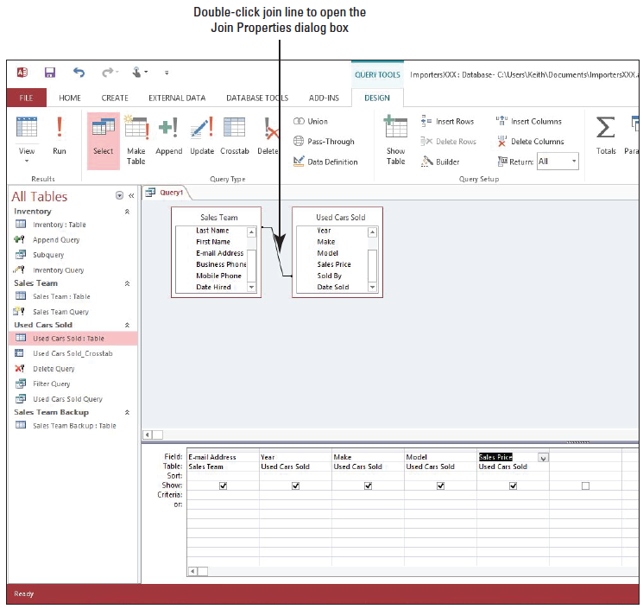
Step by Step: Create a Join
In the Used Cars Sold field list, double-click Year, Make, Model, and Sales Price. Your screen should look similar to the figure at right.

Slide 57
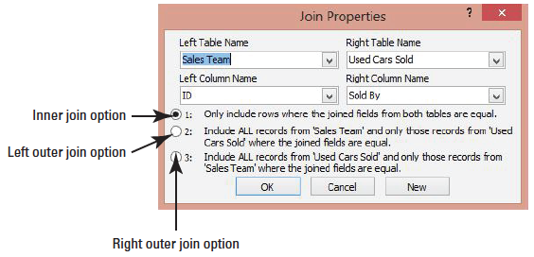
Step by Step: Create a Join
Double-click the join line between the tables, indicating which fields are joined. The Join Properties dialog box opens, as shown below.
Click the option button for option 2: and then click OK to create a left outer join.
On the DESIGN tab, in the Results group, click Run.

Slide 58
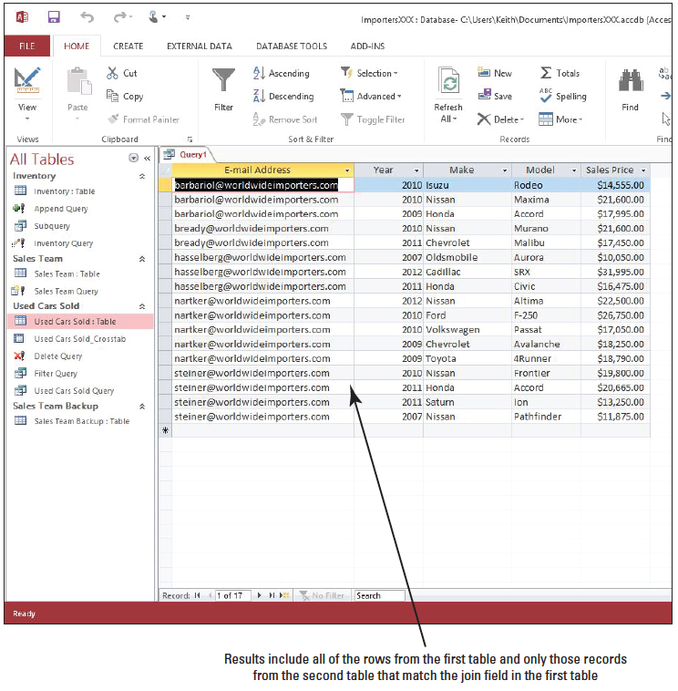
Step by Step: Create a Join
The results of the query are displayed, as shown at right.
Save the query as Join Query and CLOSE.
LEAVE the database open.
PAUSE. LEAVE Access open to use in the next exercise.
Notes:
Another Way: You can also display the Property Sheet pane by right-clicking the expression and choosing Properties from the shortcut menu that appears.

Slide 59
Step by Step: Create a Calculated Query Field
USE the database that is open from the previous exercise.
On the CREATE tab, in the Queries group, click Query Design.
In the Show Table dialog box, double-click Inventory to add the table to the design grid.
Click Close.
In the Inventory field list, double-click Year, Make, Model, AskingPrice, and TradeInValue.
Click the Field cell in the first blank column (to the right of the TradeInValue field) and click the Builder button in the Query Setup group to open the Expression Builder dialog box.

Slide 60
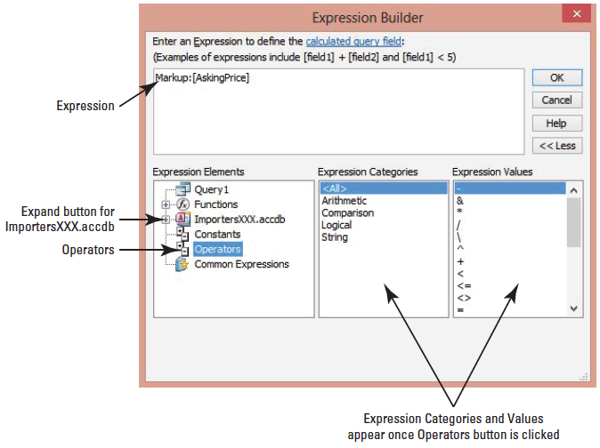
Step by Step: Create a Calculated Query Field
In the blank area of the dialog box, key the following: Markup: [AskingPrice]
In the Expression Elements category, click Operators. The dialog box should resemble the figure at right.
In the Expression Values category, double-click the minus sign (–). The minus sign should appear in the expression and next to the AskingPrice field.

Slide 61
Step by Step: Create a Calculated Query Field
In the Expression Elements category, click the expand button next to ImportersXXX. accdb. Tables, Queries, Forms, and Reports should appear under ImportersXXX.accdb.

Slide 62
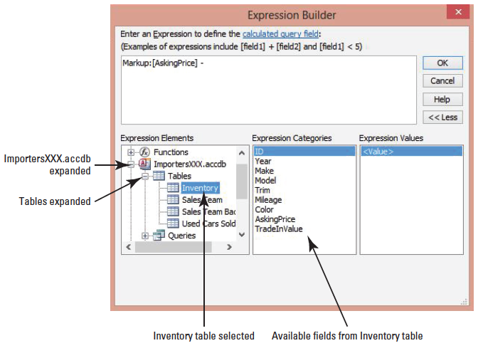
Step by Step: Create a Calculated Query Field
In the Expression Elements category, click the expand button next to Tables to expand it. The available table names appear. Click Inventory. The available fields from the Inventory table should appear in the Expression Categories box. Your screen should resemble the figure at right.

Slide 63
Step by Step: Create a Calculated Query Field
In the Expression Categories box, double-click TradeInValue; [Inventory]! [TradeInValue] should appear in the expression and next to the minus sign (–).
Click OK.
Click the Field cell in the first blank column (to the right of the newly created calculated field) and click the Builder button in the Query Setup group to open the Expression Builder dialog box.
In the blank area of the dialog box, key the following: Markup in Euros: ([AskingPrice]—[TradeInValue]) * .7534
Click OK.
Notes:
Take Note: The part of the expression that reads [Inventory]![TradeInValue] specifies that the TradeInValue field originates from the Inventory table; however, even though Access automatically formats it this way, this expression format is not required since you’re already referencing the Inventory table in the Table row of the design grid.

Slide 64
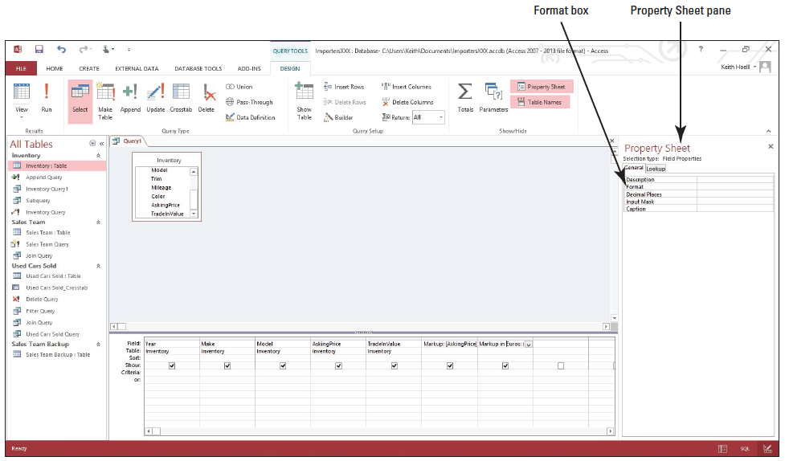
Step by Step: Create a Calculated Query Field
On the DESIGN tab, in the Show/Hide group, click the Property Sheet button. The Property Sheet pane is displayed, as shown below.

Slide 65
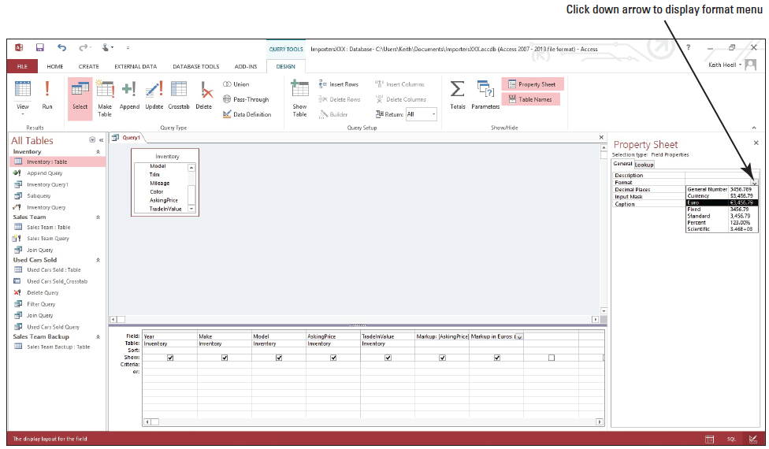
Step by Step: Create a Calculated Query Field
Click the empty cell next to the Format box, then click the down arrow to display the Format menu, as shown below. Select Euro from the options that appear to format the expression result as Euro.

Slide 66
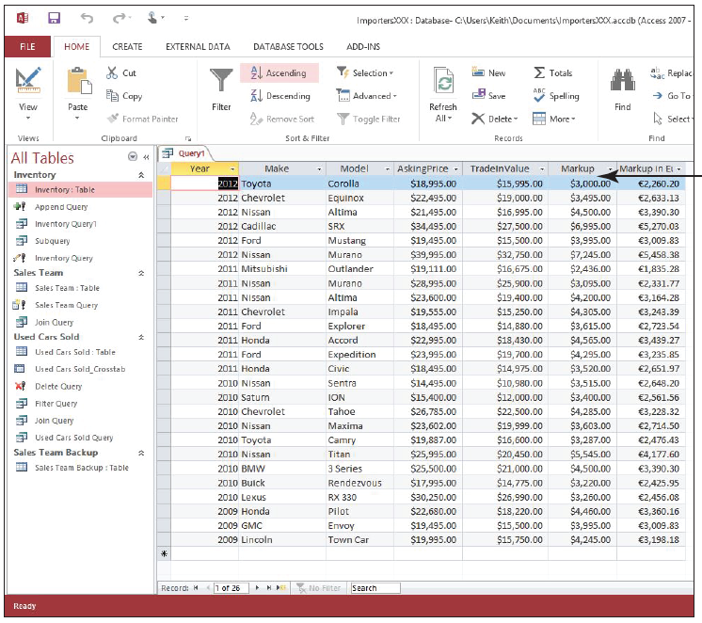
Step by Step: Create a Calculated Query Field
On the DESIGN tab, in the Results group, click Run. The query with the new calculated Markup and Markup in Euros fields is displayed, as shown at right.
SAVE the query as Calculated Query and CLOSE.
LEAVE the database open.
PAUSE. LEAVE Access open to use in the next exercise.

Slide 67
Step by Step: Create an Aggregated Query
USE the database that is open from the previous exercise.
On the CREATE tab, in the Queries group, click Query Design.
In the Show Table dialog box, double-click Inventory to add the table’s field list window to the design grid.
Click Close.
In the Inventory field list, double-click Year, Make, Model, Mileage, AskingPrice, and TradeInValue to add them to the design grid.
On the DESIGN tab, in the Results group, click Run.
On the HOME tab, in the Records group, click the Totals button. Scroll down, if necessary, to see the Total row at the bottom of the result set.

Slide 68
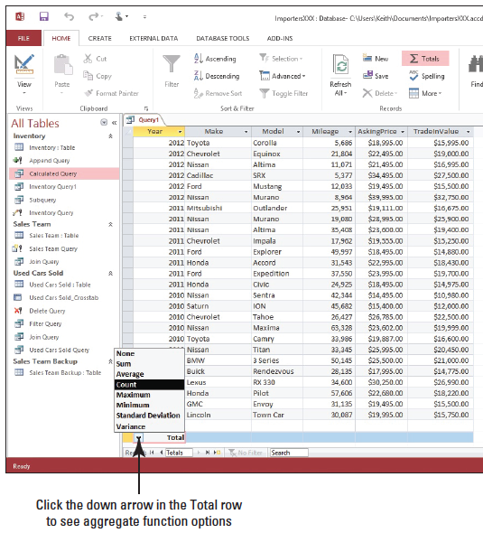
Step by Step: Create an Aggregated Query
In the Total cell of the Year field, click the down arrow to display the menu and click Count, as shown at right. Notice the cell displays 26, denoting 26 values (years) in the Year column.
Click the down arrow in the Total cell of the Mileage field and click Average.

Slide 69

Step by Step: Create an Aggregated Query
Click the down arrow in the Total cell of the AskingPrice field and click Maximum.
Click the down arrow in the Total cell of the TradeInValue field and click Sum. Your Total row should appear similar to the figure at right.

Slide 70
Step by Step: Create an Aggregated Query
Switch to Design view and remove the Model, Mileage, AskingPrice, and TradeInValue fields from the design grid. The Year and Make fields should be the only ones remaining on the grid.
On the DESIGN tab, in the Show/Hide group, click the Totals button. A new Totals row should appear below the Table row on the design grid.
Click the Group By cell below the Make field cell and click the down arrow to display the aggregate function menu.

Slide 71

Step by Step: Create an Aggregated Query
Click the Count aggregate function to select it from the menu, as shown at right.

Slide 72

Step by Step: Create an Aggregated Query
Switch to Datasheet view. Your screen should resemble the figure at right. Notice the records in the Make field are grouped by Year and counted with the results appearing in a new column named CountOfMake. Also notice the Year field is grouped and each year remains counted as applied from the aggregate function we created previously in Datasheet view.

Slide 73
Step by Step: Create an Aggregated Query
SAVE the query as Aggregated Query and CLOSE it.
CLOSE the database.
PAUSE. CLOSE Access.

Slide 74
Skill Summary

